Slide 1
Unit 3: Text-Based Programming
Lesson 13

Slide 2
What is Abstraction?
Abstraction is the act of removing complexity from a problem by hiding background details and information.
Let’s imagine using abstraction to make our Robot wave. To make the Robot wave you could give it the following instructions: lift up your arm open your hand move your arm left move your arm right move your arm left move your arm right close your hand lower your arm

Slide 3
That would be a lot of instructions to give each time we wanted to make our robot “wave”. It would be much simpler if we could teach our robot how to wave once, and each time after that we could simply give it the instruction wave. how to wave: lift up your arm open your hand move your arm left move your arm right move your arm left move your arm right close your hand lower your arm wave wave wave

Slide 4
Abstraction is a fundamental concept of computing (not just programming): it’s how technology has been able to progress at ever increasing speeds by continually abstracting problems, so that the next person who faces the same problem doesn’t have to be concerned about the detail.
You are going to create functions in Python to simplify and reuse code in your programs.

Slide 5

Functions
You have already used some functions in Python, such as print and input. While they are “in-built” and you can’t see their code, they were created in a very similar way to the programs you have written. In this next section you will create your own functions.
The syntax to create a function in Python looks like this:
def stands for “definition”, since what you are doing when creating a function is defining it and giving it a name.
Between the def and the () is the name of your function followed by :. Indented under the : is the code which should be run as part of the function.

Slide 6
When you want to use (or call) a function you use the name with parentheses:
my_function()
Tip: Like variables, functions can be given any name you wish, but it is a good idea to name your functions after the job they do.

Slide 7
Creating a Function
Create a new program called functions.
Use def to add a function at the top of your program called intro.
Indented under this line, add some code to print a message.
Call your intro function from your program.
Note: this line of code is not indented under the def as it doesn’t belong to the function definition.

Slide 8


Your program should now look similar to this:
Run your program. You should see your message.

Slide 9
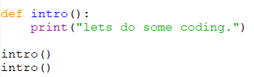

Change your code so the function is run twice, by adding a second call to intro at the bottom of your program. intro() intro()
Run your program again. You will see that the message is printed twice.

Slide 10
Using functions in this way allows you to reuse your code: you don’t have to write out all the steps every time. It also makes the code easier to understand and change.
Try amending your intro function so it prints out a second message or asks the user for some input.

Slide 11
Using value from functions
There are two ways that we will use the values from functions and depending on what we are using them for one way is better than the other.
Use global variable
A global variable is one that can be accessed by all parts of your code. If you create a variable inside a function then it will be a local variable by default. Local variables can only be used inside the function that they are created in.

Slide 12
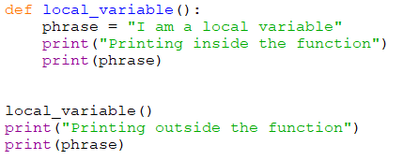
Try this code to see what happens

Slide 13
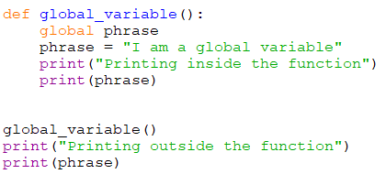
Make phrase a global variable and run it again.

Slide 14
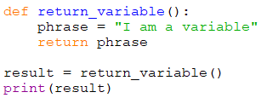
Using value from functions
2. Return values from functions
You can return any variables that you use in a function back to where the function was called from. To do this you have to assign the function to a variable using the = sign.
You can return more than one variable too.

Slide 15
Using functions in your bot program
“If you can see that your program contains duplicated or very similarly structured code, then a function might help”.
**** You should make a copy of your Bot 2 program so you won’t lose it if you make a mistake. Name it Bot_with_functions.

Slide 16
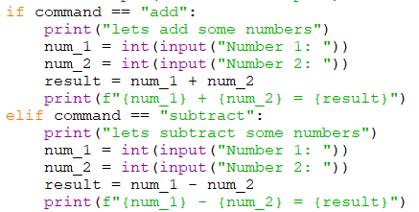
If you look at your bot program, you will notice that the code which calculates the addition and subtraction contains a lot of duplication and is very similar:

Slide 17
In this section, you’ll turn these segments of code which add and subtract into one function called do_calculation, which will remove as much of the duplicate code as possible, and abstract the complexity of doing calculations on two numbers.
First, let’s identify the differences between the code which adds and the code which subtracts. This will allow us to see where our new function will need to differ from the existing code:
The print statement says “add” or “subtract”
Either the + or - operator is used to calculate the result
The operator printed by the final print statement is also different.

Slide 18
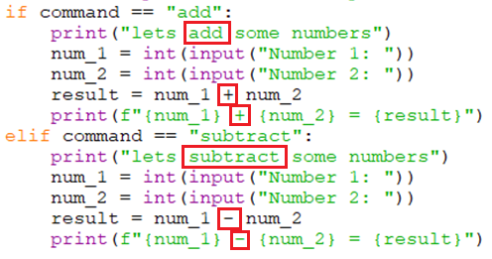

Slide 19
There are only three areas where the code differs. The do_calculation function will cater for the differences by using data held in variables or using selection to either add or subtract.
At the top of your bot program, use def to create a new function called do_calculation.
The first step in our function is to print out “lets [add/subtract] some numbers”, adding in the operation as appropriate.

Slide 20
The first step in our function is to print out “lets [add/subtract] some numbers”, adding in the operation as appropriate.
Use a print statement to output the message using the command variable to include the operation.
Note: this code, and the rest of the function below, is indented under the do_calculation definition, to show Python that it is part of the function.

Slide 21


The function should then ask the user for two numbers and convert them to integers.
You then need to calculate the result using either a + or - operator, which you can do using an if:

Slide 22
The final step in the function is to print out the result including the calculation, e.g. “1 + 2 = 3” or “4 - 1 = 3”. Again there is a difference which your function will need to deal with, to decide whether to output a “+” or a “-“.
You now have a choice about how you implement this change:
You could create a new variable called operator, set this to either “+” or “-“ in the existing if, and use that to output the variable.
You could include a print statement inside the if and elif sections.
Both options will work and are described in the next slides. You should review these options, decide which you prefer, and then add it to your code.

Slide 23
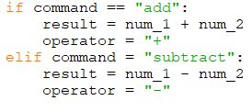
Option 1
In the if statement which calculates the result, create a variable called operator and set it to be either “+” or “-“.
Output the result using the operator variable.

Slide 24
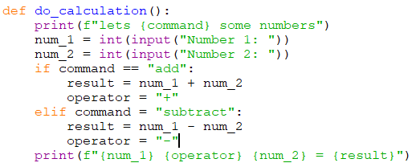
The completed do_calculation function should look like this:

Slide 25
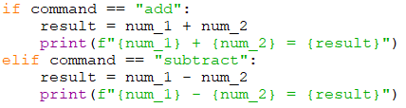
Option 2
Add separate print statemenst

Slide 26
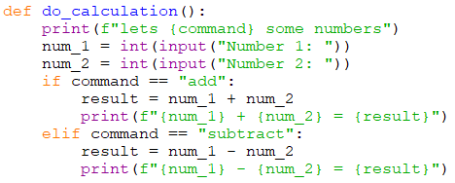
Your completed do_calculation function should look like this:

Slide 27
Now that you have a function which will calculate either addition or subtraction, you need to call it from your bot program.
Remove all the old code which did the calculation for “add” and “subtract” commands, and call your do_calculation function instead. if command == "add": do_calculation() elif command == "subtract": do_calculation()
Run your program and test your bot.
Tip: - a mistake people often make when calling a function is leaving out the round brackets () - if you leave them out, your program will still start but your function won’t run, so if there are no errors but nothing is happening, check your ().

Slide 28
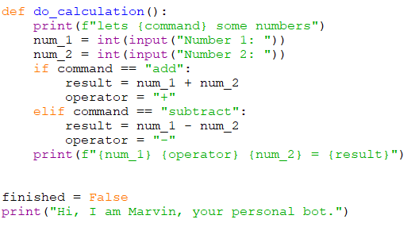
Your Bot should now look similar to this:
Continued on
next page

Slide 29
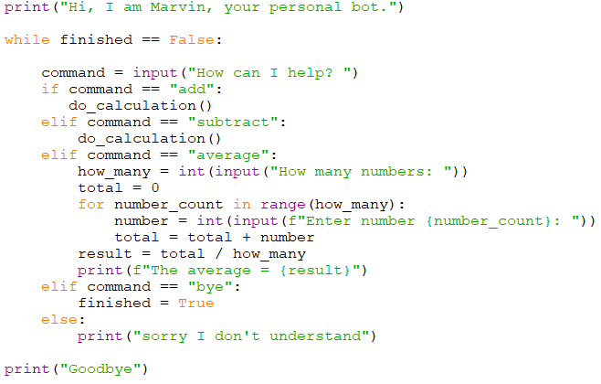

Slide 30
Portfolio 9 – Completed Bot Add multiplying and dividing to your function
Modify the do_calculation() function in your bot to include multiplication and division.
Save it as your_name_u3_port_9

